Slide 1
How to customize the homepage using the “Landing Page” tab of the view configuration
In Primo VE NDE
Yoel Kortick | May 2026

Slide 2
Agenda
  Introduction
  Accessing the "Landing Page" tab
  Change the Home Page background
  Customize the Links section
  Customize the Elements order

Slide 3
Introduction

Slide 4
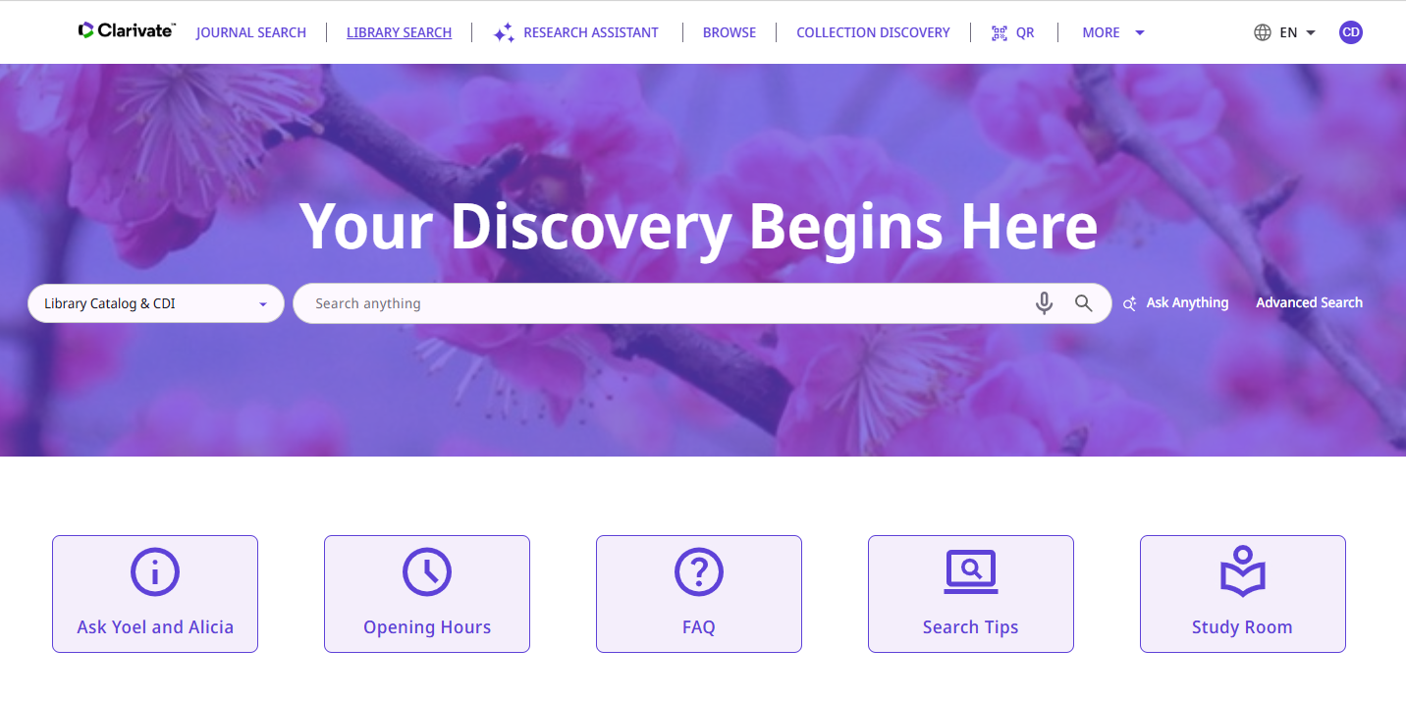
Introduction
The landing page is the entry point for library discovery in the NDE UI.
The path for the landing page is … /nde/home. For example:
https://my.alma.exlibrisgroup.com/nde/home?vid=MY_INST:NDE&lang=en

Slide 5
Introduction
The Primo VE NDE UI offers an easy way to configure the landing page. Institutions can either (or both)
  Use the current customization package option
    See for example the following detailed step by step explanations:
      How to use the Primo VE NDE Customization Package to customize the library logo
      How to use the Primo VE NDE Customization Package to add headers and footers
      How to use the Primo VE NDE Customization Package to change the Homepage
      How to use the Primo VE NDE Customization Package to customize a color theme
  Use the “Landing Page” tab of the Primo VE NDE View Configuration
Note that customization for all other pages is still controlled by the customization package.

Slide 6
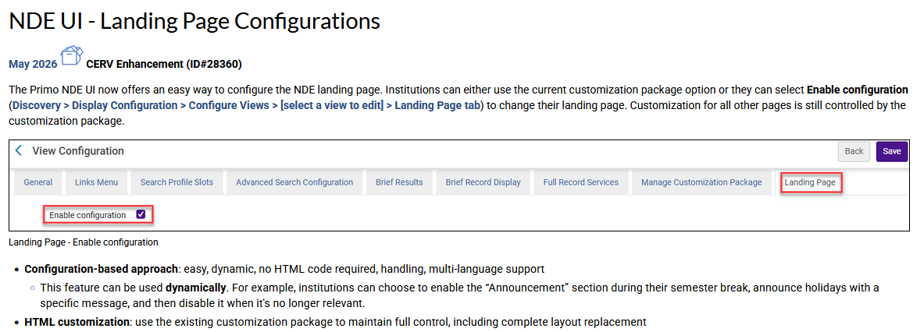
Introduction
From the May 2026 Primo VE Release notes:

Slide 7
Introduction
Regarding the simultaneous use of both the “Customization Package” and the ”Landing Page” tab of the Primo VE NDE View Configuration (part 1 of 2):
The NDE landing page configuration makes it easy to create and update landing page content without code.
In parallel, the customization package should still be used for broader branding and structural elements, such as the header, footer, library logo, and more.
Additionally, even when using the landing page configuration, it is possible to customize icons using the customization package (e.g., in the assets/icons folder).

Slide 8
Introduction
Regarding the simultaneous use of both the “Customization Package” and the ”Landing Page” tab of the Primo VE NDE View Configuration (part 2 of 2):
For more advanced requirements, both approaches may be combined:
Use the landing page configuration for layout and content
Extend functionality via the advanced customization package by developing custom components and connecting them to elements on the landing page
Overall, there are multiple flexible options, and these approaches can work together to support both simple configurations and more advanced customization scenarios.

Slide 9
Introduction
This presentation will focus on using the Landing Page tab, and not on the Customization Package.
In addition to this presentation see also Configuration Changes for the Landing Page.

Slide 10
Accessing the "Landing Page" tab

Slide 11
Accessing the "Landing Page" tab
The “Landing Page” tab of the Primo VE NDE View Configuration is accessed as follows:
  From within Alma choose “Discovery > Display Configuration > Configure Views”
  Select a Primo VE NDE view to edit
  Switch to the Landing Page tab.

Slide 12
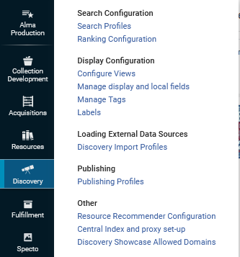
Accessing the "Landing Page" tab
From within Alma choose “Discovery > Display Configuration > Configure Views”

Slide 13
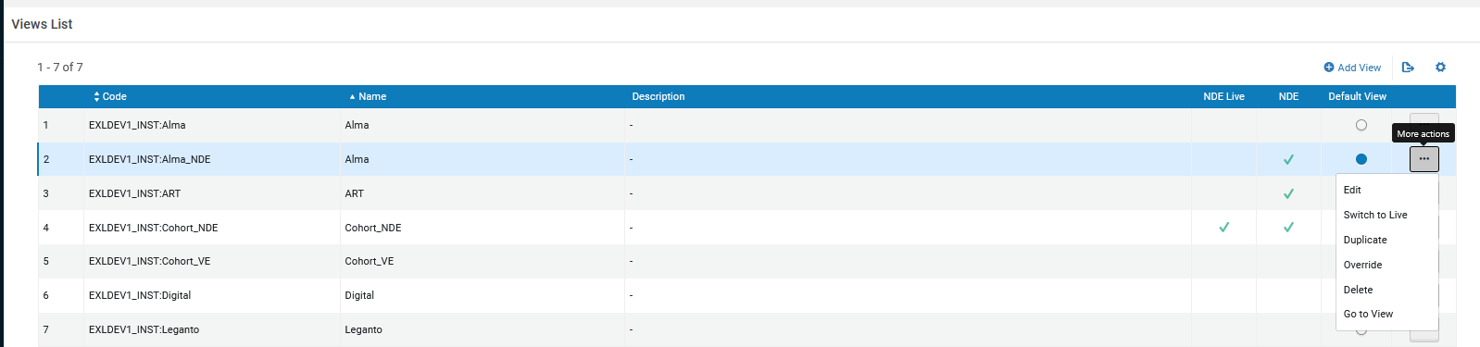
Accessing the "Landing Page" tab
Select a Primo VE NDE view to edit

Slide 14
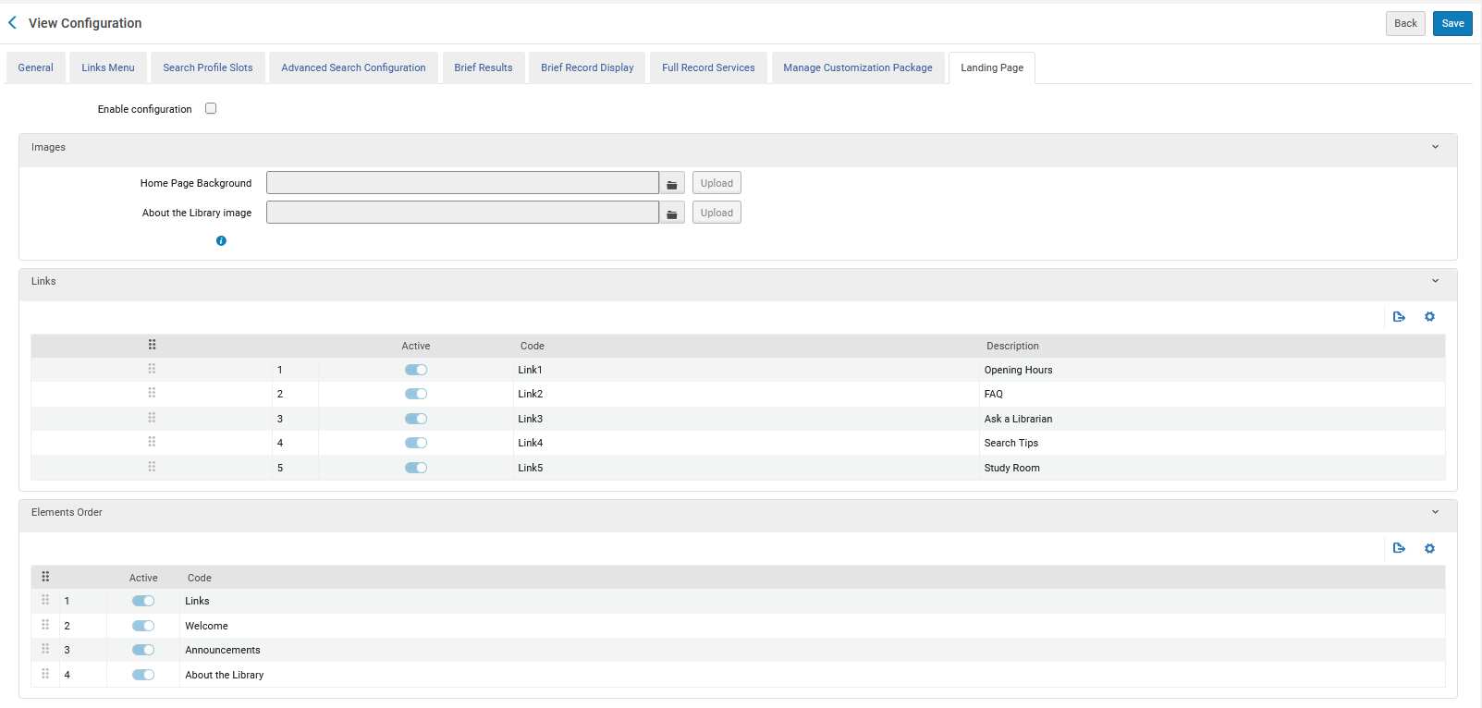
Accessing the "Landing Page" tab
Switch to the Landing Page tab

Slide 15
Change the Home Page background

Slide 16

Change the Home Page background
We will now change the Home Page background to be the Taiwan National Flower (the plum blossom).
We will use the Wikimedia Commons image “MeihuaShan 1.jpg” found here.

Slide 17
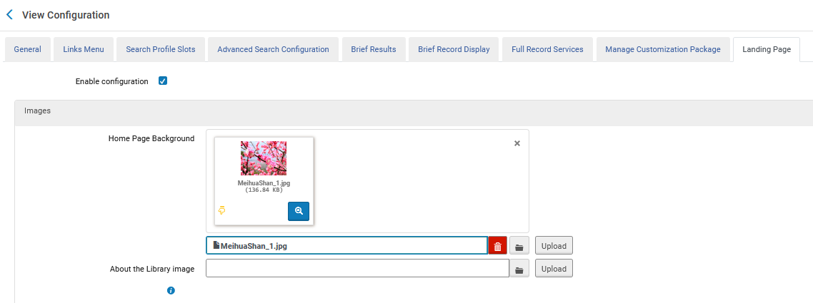
Change the Home Page background
Check “Enable Configuration” and then select the file and then click “Upload”.
1. Check “Enable Configuration”
2. Select the file
3. Now we will click “Upload”

Slide 18
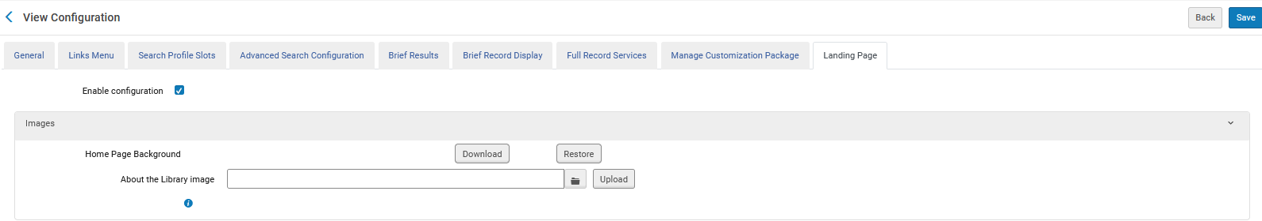
Change the Home Page background
After clicking “Upload” click “Save”.

Slide 19

Change the Home Page background
The background image has changed:

Slide 20
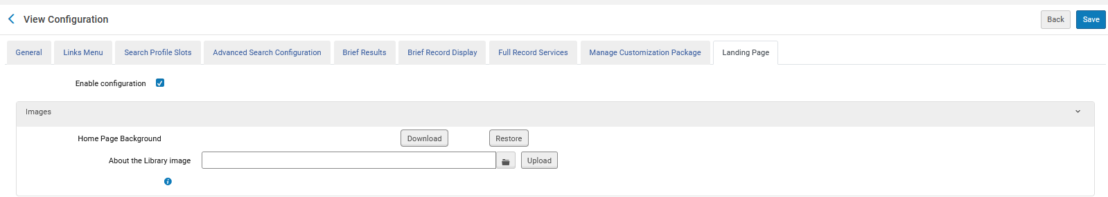
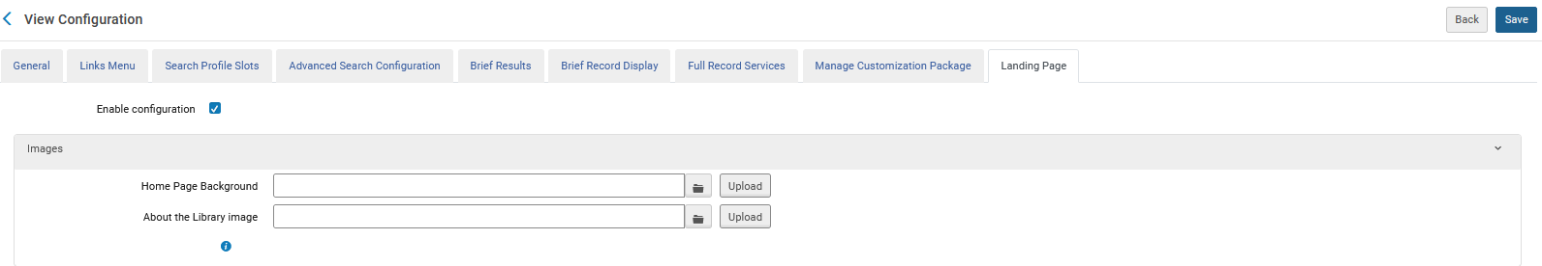
Change the Home Page background
Now we will restore the background image to the original:
Step 1
Step 2

Slide 21

Change the Home Page background
The background image has been restored to the original:

Slide 22
Customize the Links section

Slide 23
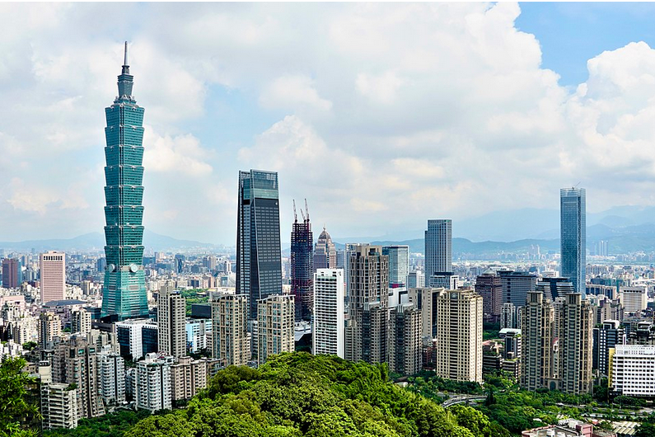
Customize the Links section
We will now Customize the Links section to be an image of Taipei
We will use the Wikimedia Commons image “Taipei_Skyline_2022.06.29.jpg” found here.

Slide 24
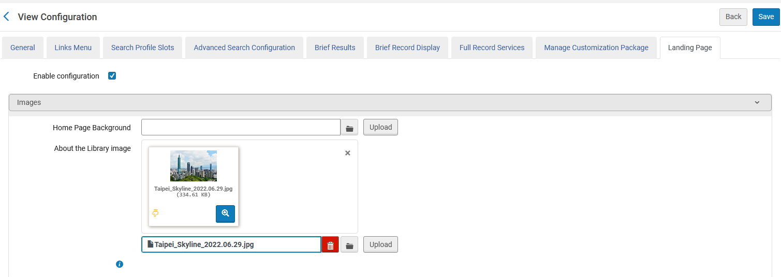
Customize the Links section
Check “Enable Configuration” and then select the file and then click “Upload”.
1. Check “Enable Configuration”
2. Select the file
3. Now we will click “Upload”

Slide 25
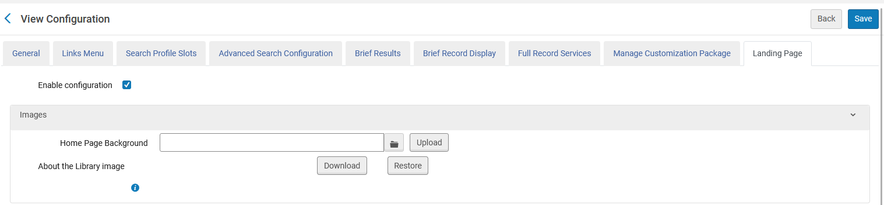
Customize the Links section
After clicking “Upload” click “Save”.

Slide 26
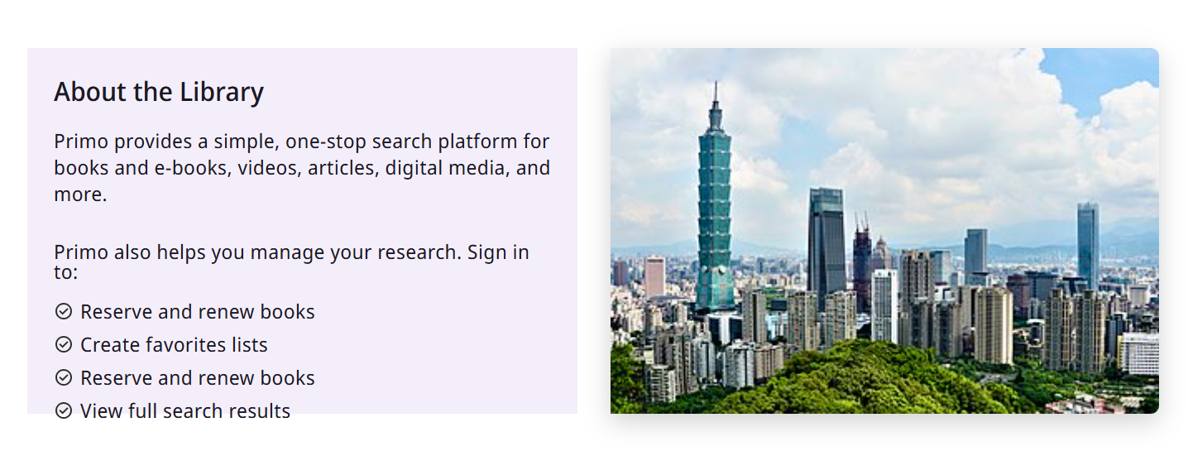
Customize the Links section
The About the Library image has changed:

Slide 27
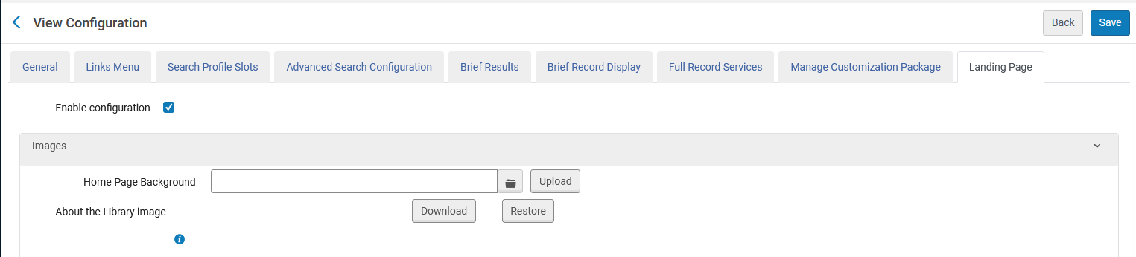
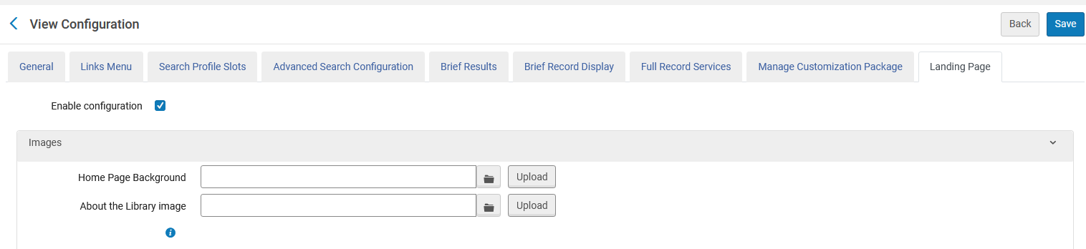
Customize the Links section
Now we will restore the background image to the original:
Step 1
Step 2

Slide 28
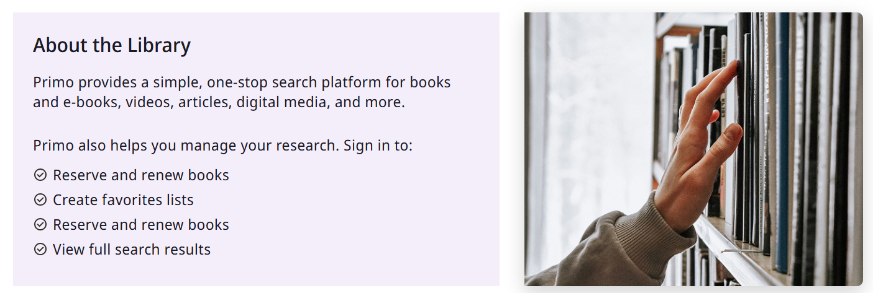
Customize the Links section
The About the Library image has been restored to the original:

Slide 29
Customize the Links section

Slide 30
Customize the Links section
To customize the Links section:
Select Customize.
Activate/Inactivate the number of links to display. Out-of-the-box, five links are set to Active.
Use the drag / reorder icon to reorder the links.
From the More actions menu select Edit. From here it is possible to change the:
  Label
  URL — must include http:// or https://
  Icon

Slide 31
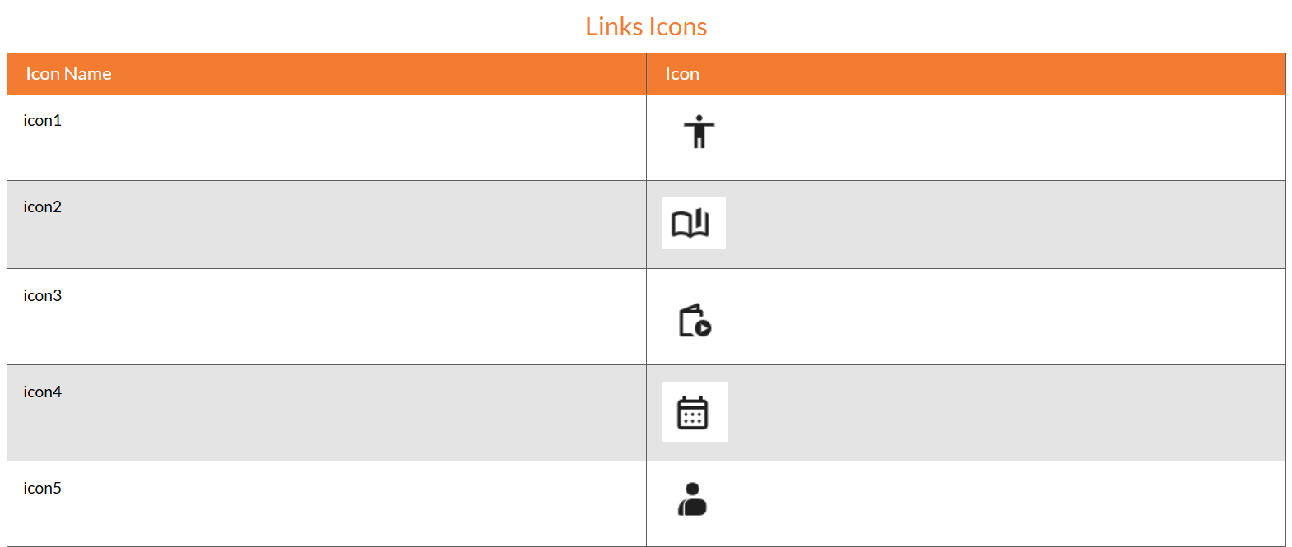
Customize the Links section
Configuration Changes for the Landing page lists various icons which may be used:
There are 16 different icon options. This is just a selection of the possibilities.

Slide 32
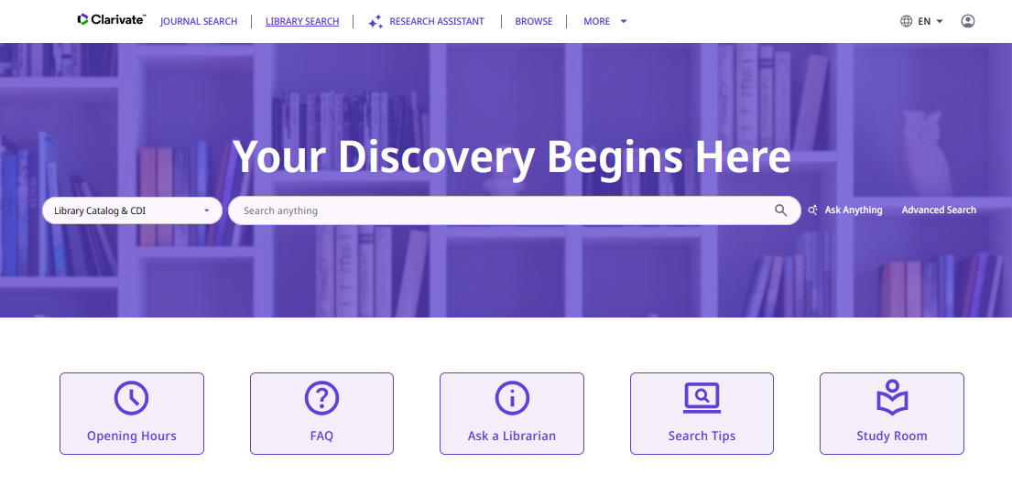
Customize the Links section
Here are the links we now have on the Landing page
There are 16 different icon options. This is just a selection of the possibilities.
These links correspond to the configuration (seen on the next slide) in the “Links” section of the “Landing Page” tab of the Primo VE NDE View Configuration.

Slide 33
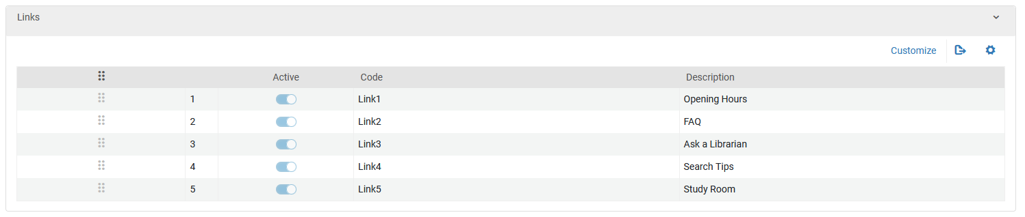
Customize the Links section
From the “Landing Page” tab of the primo VE NDE View Configuration click “Customize” in the Links Section

Slide 34
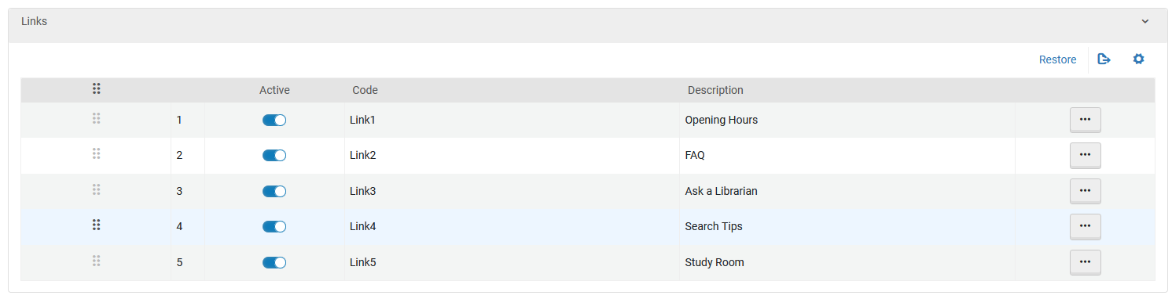
Customize the Links section
Now we will drag “Ask a Librarian” to the top

Slide 35
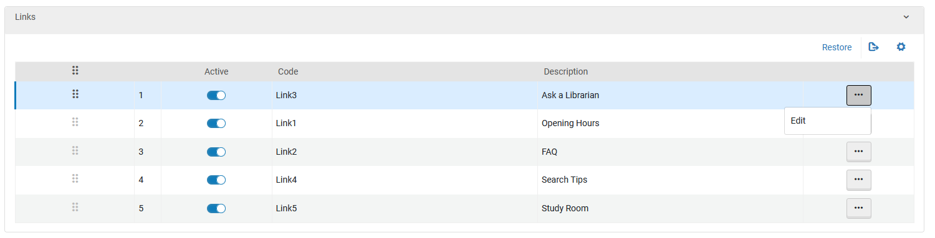
Customize the Links section
Now “Ask a Librarian” is on the top and we will edit it

Slide 36
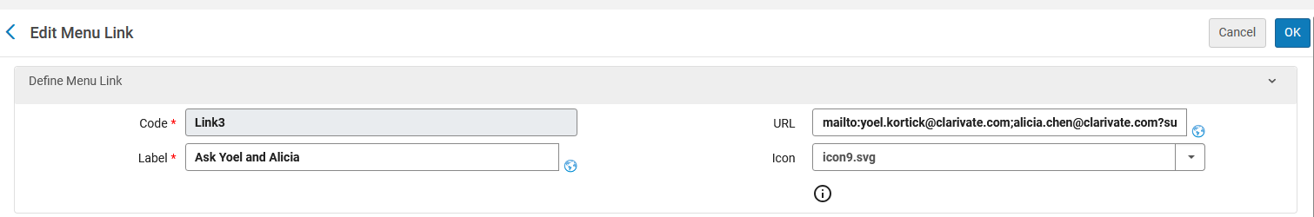
Customize the Links section
We changed the label from “Ask a Librarian” to “Ask Yoel and Alicia”
We made the URL be:
mailto:yoel.kortick@clarivate.com;alicia.chen@clarivate.com?subject=My%20question%20for%20Yoel%20and%20Alicia&body=Hi%20Yoel%20and%20Alicia%0AHere%20is%20my%20question:

Slide 37
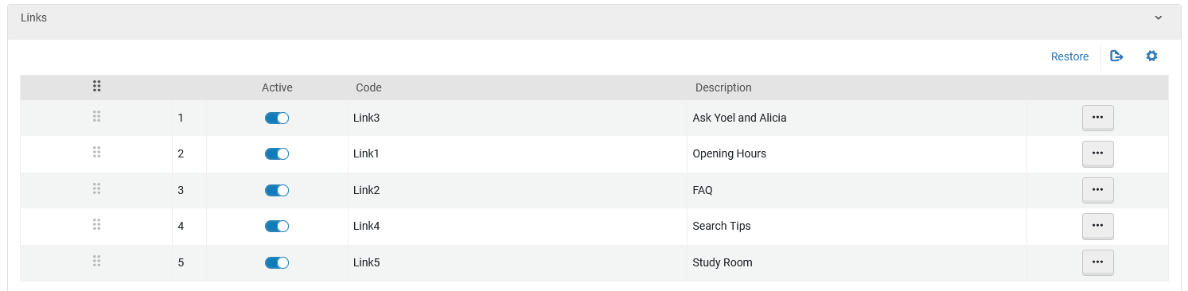
Customize the Links section
Now “Ask a Librarian” is on the top and is called “Ask Yoel and Alicia”

Slide 38
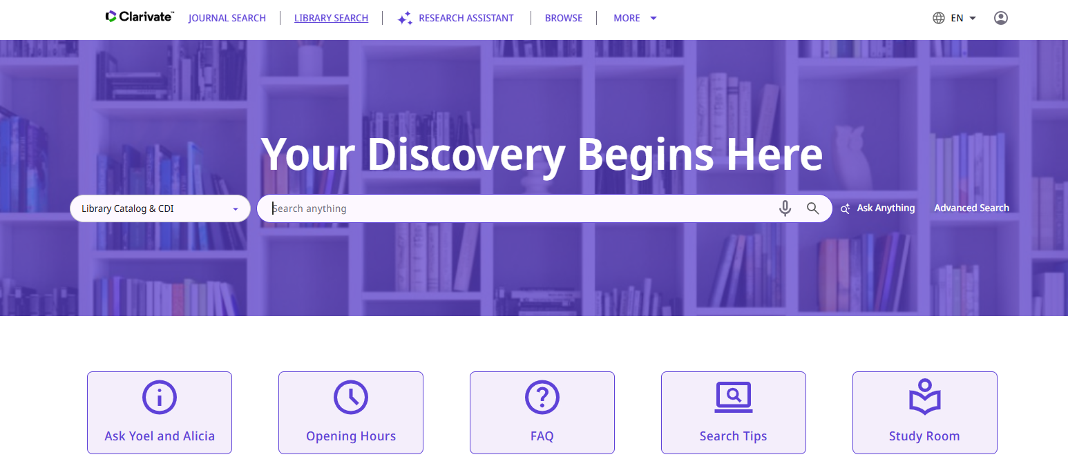
Customize the Links section
Now we see the changes on the Landing Page
“Ask a Librarian” is now called “Ask Yoel and Alicia” and it appears first. We will now click it

Slide 39
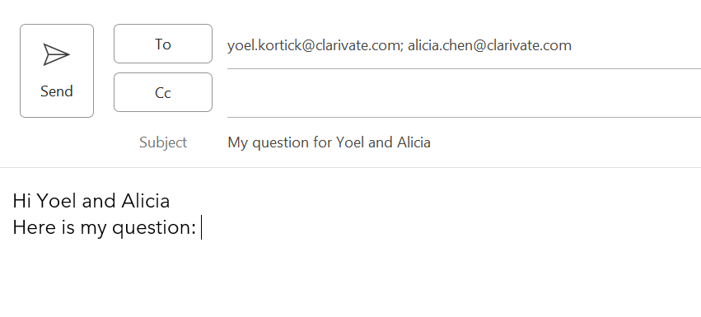
Customize the Links section
After clicking “Ask Yoel and Alicia” this email opens:

Slide 40
Customize the Elements order

Slide 41
Customize the Elements order
Currently the elements on the Primo VE NDE Landing Page are in the following order:
Links
Welcome
Announcements
About the Library

Slide 42
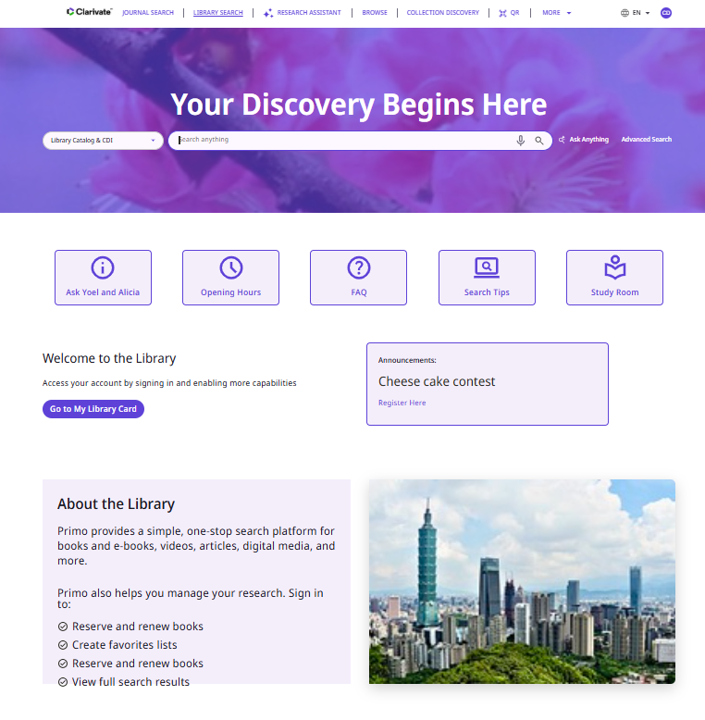
Customize the Elements order
Links
Welcome
Announcements
About the Library

Slide 43
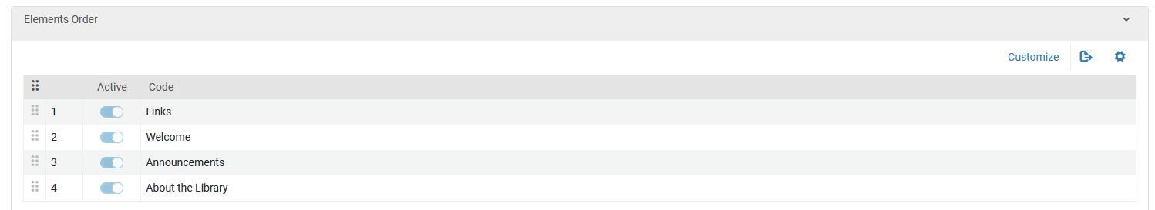
Customize the Elements order
The elements are in the current order because this appears on the “Landing Page” tab of the Primo VE NDE View Configuration:

Slide 44
Customize the Elements order
Now we will change the elements order on the Primo VE NDE Landing Page to be in the following order:
Links
About the Library
Welcome
Announcements
“Welcome” used to be second and is bow third
“Announcements” used to be third and is now fourth
“About the Library” used to be fourth and is now second

Slide 45
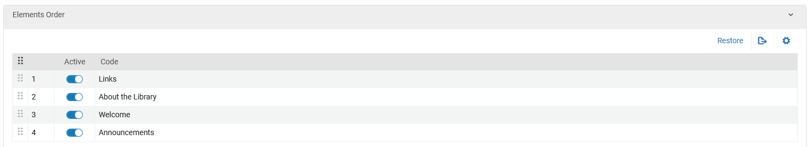
Customize the Elements order
We clicked “Customize” and made the changes:

Slide 46
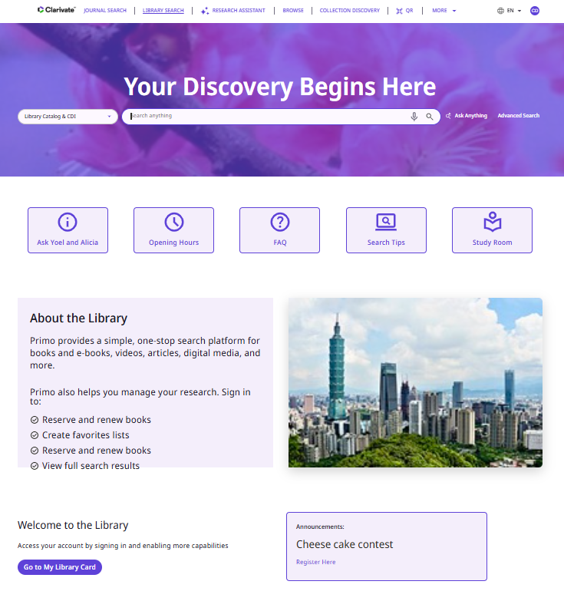
Customize the Elements order
We see the changes
Links
About the Library
Welcome
Announcements

Slide 47
Thank You

